Slide 1

COMP902 Advanced Information Technology Specialised Project Trimester 2, 2026 Final Report
Prepared for: Dr. Saranya Selvarangan
Prepared by: Viacheslav Vorozhbit – 20230119
11/08/2026

Slide 2

Research Topic and Problem
AI-Assisted Construction Workplace Management System
Why were small construction companies chosen?
Small businesses might only have one or two managers.
Many administrative duties are carried out by managers themselves.
Information processing, papers, attachments, and emails are repetitive.
Big businesses can rely on specialised IT support and enterprise systems.
Accessible and useful solutions are necessary for small businesses.
Main Idea:
How can AI reduce routine workload without replacing the manager?

Slide 3
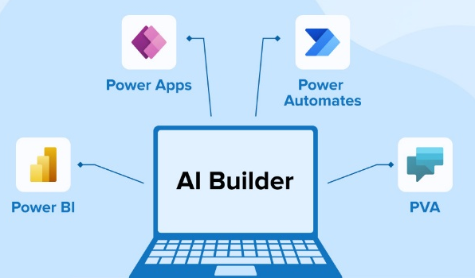
The aim and objectives of the research
Investigate the use of AI in construction management
Determine appropriate, accessible technologies
Look at automating workflows
Test document processing using AI
Investigate AI mini-assistants
Consider the advantages and restrictions

Slide 4
Literature Review
AI as assistant
AI in construction management
Automating workflows
The potential of AI technology
Outcome:
Limited practical focus on combining accessible AI with low-code automation for small construction enterprises

Slide 5
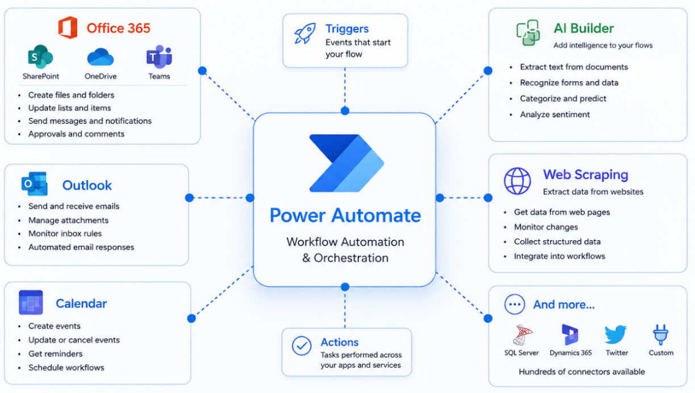
Methodology
→ Technology Investigation → Workflow Design → Practical Testing → Evaluation → Findings

Slide 6
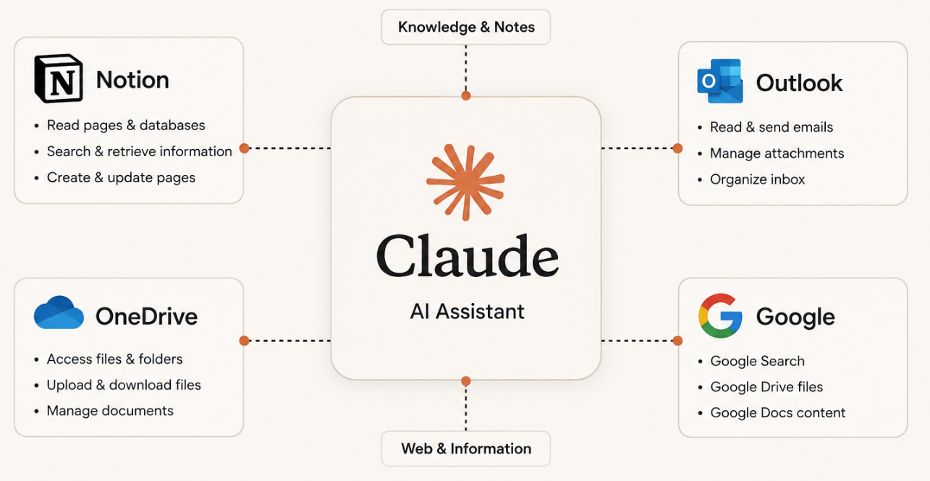
Technologies Investigated
MS Power Automate
AI ChatGPT
AI Copilot
AI Builder
AI Claude
AI Cursor
AI Gemini
AI Grok

Slide 7
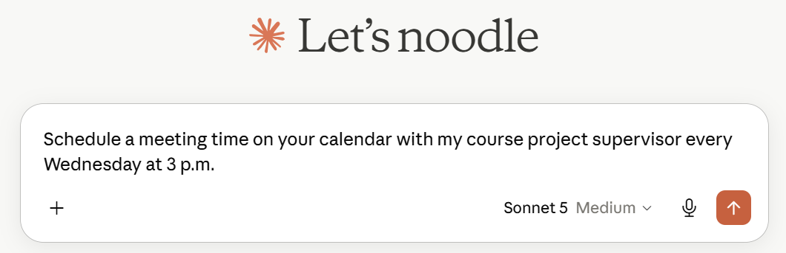
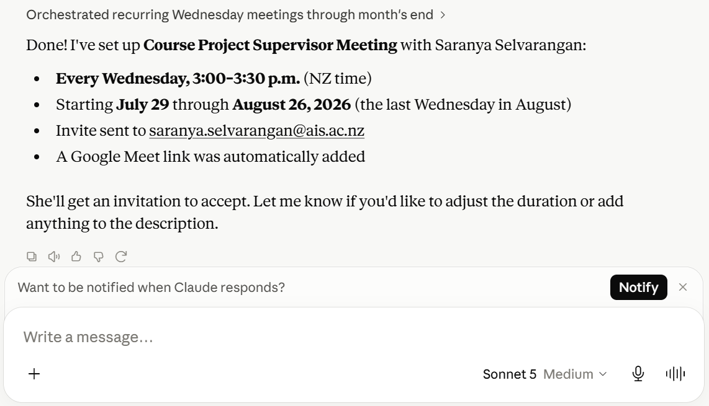
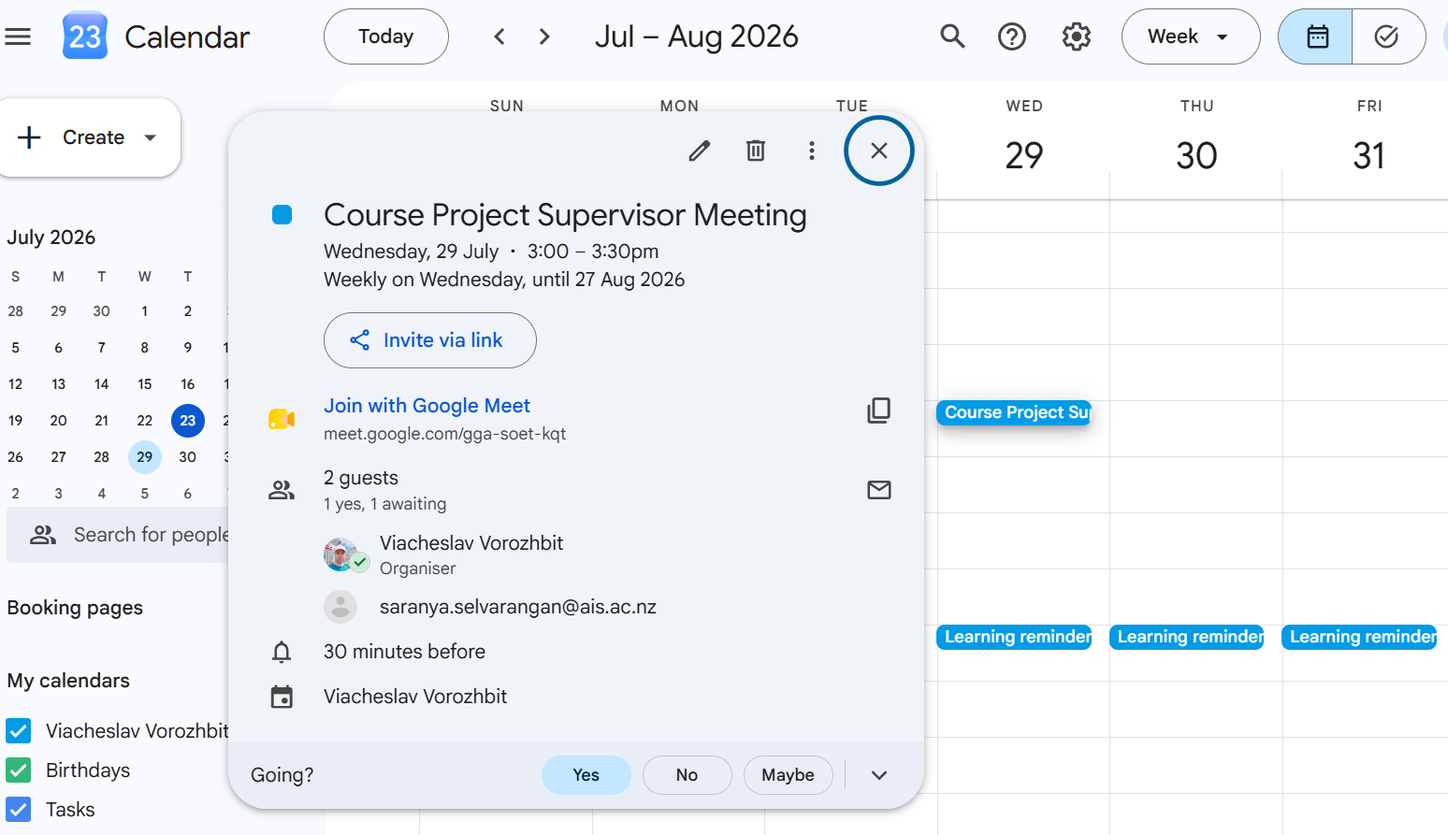
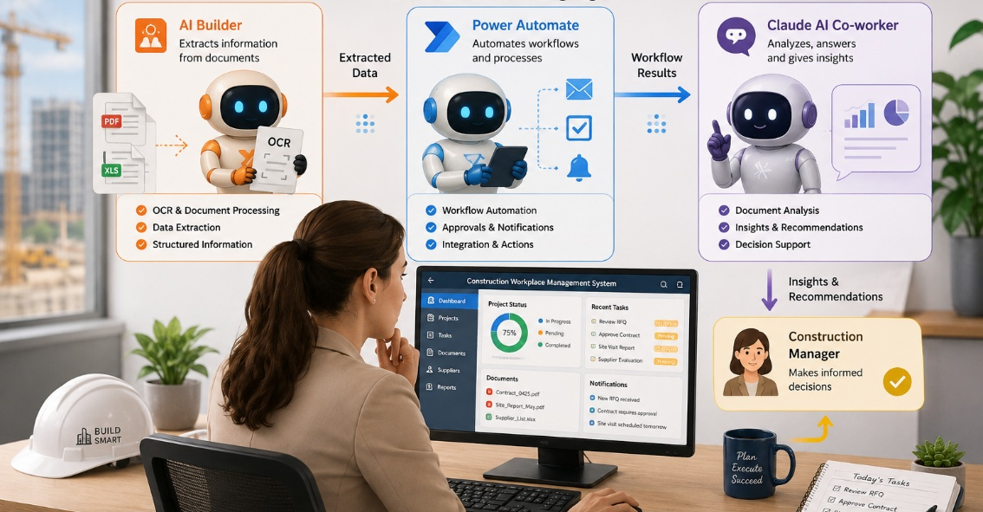
Concept mini-assistants

Slide 8
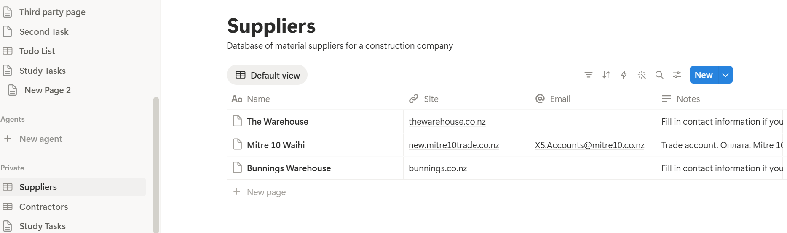
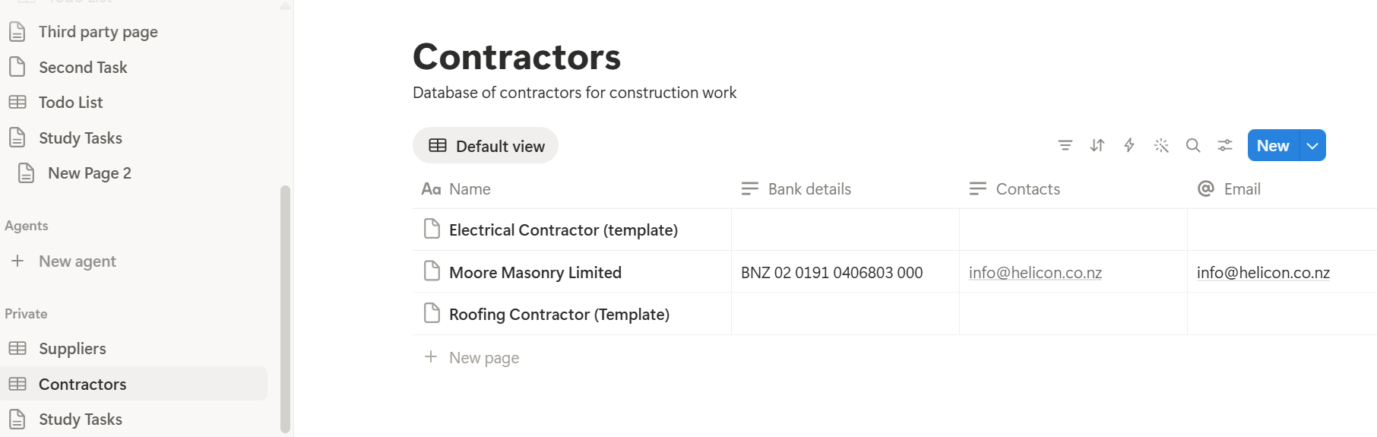
Claude Cowork and Notion

Slide 9

Results & Key Findings
Many AI technologies have potential
Some require significant technical knowledge
Power Automate provides an accessible low-code approach
AI Builder adds intelligence to workflows
Claude provides broader AI assistance
Technologies work better in combination

Slide 10
Conclusion and Future Work
AI-assisted automation has significant potential for small construction companies
Routine administrative tasks
Use AI as a digital coworker
Managers remain responsible for important decisions
Future Work
More specialised AI mini-assistants
Local/private AI for sensitive data
Wide combination tools
Deep learning AI
Quantitative measurement of time saved

Slide 11
References
Kevin Stratvert. (2021, November 17). Microsoft AI Builder Tutorial - Extract Data from PDF [Video]. YouTube. https://www.youtube.com/watch?v=J3d6bx3i4l0
Koduri, N. K., & Piridi, S. Low-Code AI-Driven Patient Intake System Using Microsoft Power Platform and AI Builder.
Leila Gharani. (2021, March 18). Streamline Excel: Power Automate tricks you need to know! [Video]. YouTube. https://www.youtube.com/watch?v=YBi9PgbnfLQ
Pothireddy, S. R. (2025). AI-Powered Copilots Are Revolutionizing Low-Code Development in the Power Platform. International Journal of Communication Networks and Information Security, 17(2), 86-115
Pragmatic Works. (2021, December 9). Power Automate Beginner to Pro Tutorial [Full Course] [Video]. YouTube. https://www.youtube.com/watch?v=1p5kI7SYz4Q
Savaş, S. (2025). Artificial intelligence in construction project management: Trends, challenges and future directions. Journal of Design for Resilience in Architecture and Planning, 6(2), 221–238. https://doi.org/10.47818/DRArch.2025.v6i2165
Stratton, J. (2024). Copilot for Microsoft 365: Harness the power of generative AI in the Microsoft apps you use every day. Apress.
Thomas Janssen. (2026, January 3). Power Automate Excel Tutorial: Add, Update and Read from Excel [Video]. YouTube. https://www.youtube.com/watch?v=M7gaUl4MsZ4
Zabala-Vargas, S., Jaimes-Quintanilla, M., & Jimenez-Barrera, M. H. (2023). Big data, data science, and artificial intelligence for project management in the architecture, engineering, and construction industry: a systematic review. Buildings, 13(12), 2944.

Slide 12

Thank you for your attention

